Slide 1
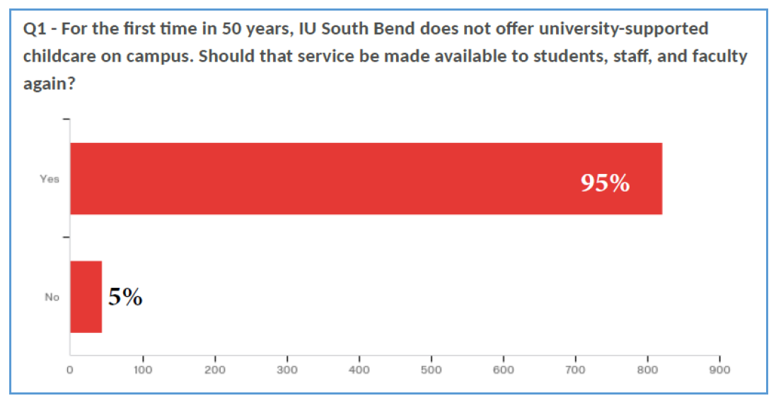
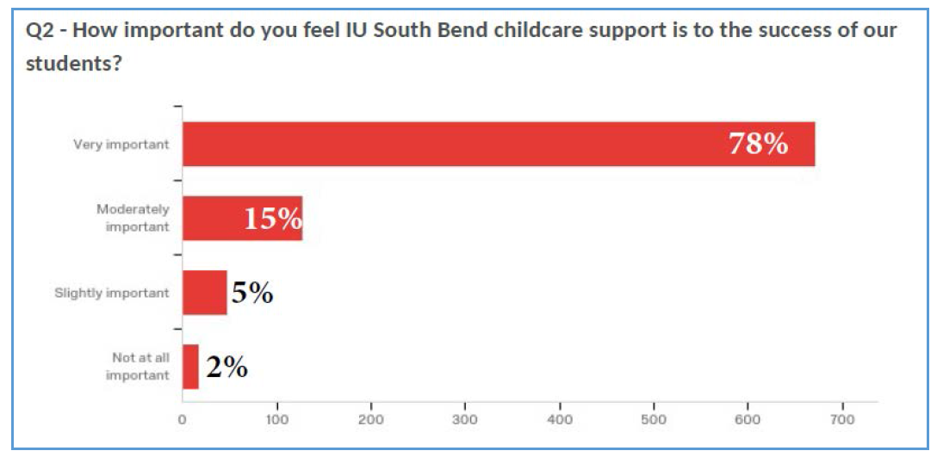
Long story short:
We received 887 responses.
67% students
18% faculty
15% staff
More than 1 in 3 had brought a child to class or office due to childcare issues.
Almost 1 in 4 know of students who miss classes or can’t attend IU South Bend for same reasons.

