Slide 1
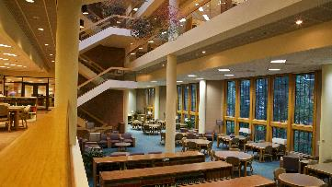
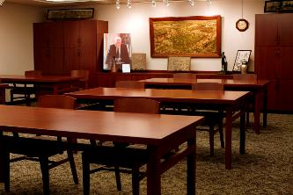
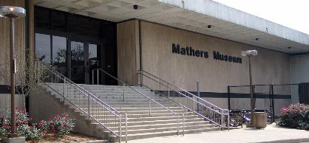
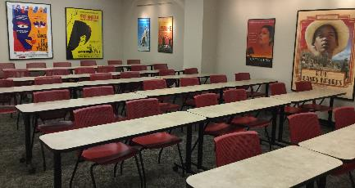
Contemporary MLK: Objects from IU Collections

Slide 2
King, Martin Luther. Why We Can’t Wait. New York: Harper & Row, [1964]. Courtesy, The Lilly Library, Indiana University, Bloomington, Indiana.

Slide 3
King, Martin Luther. Why We Can’t Wait. New York: Harper & Row, [1964]. Courtesy, The Lilly Library, Indiana University, Bloomington, Indiana.

Slide 4
King, Martin Luther. Letter From Birmingham City Jail. [Philadelphia: American Friends Service Committee, 1963]. Courtesy, The Lilly Library, Indiana University, Bloomington, Indiana.

Slide 5
John Woodrow Wilson (American, b. 1922). Martin Luther King, Jr., 2002. Etching and aquatint on chine collé. Purchased in honor of former Chancellor Sharon Brehm. Eskenazi Museum of Art, 2005. 16.

Slide 6
"Al Benson, Chicago Disc Jockey holds copies of the U.S. Constitution he intends to drop from plane over three Mississippi cities 2/22. Benson says he planned the flight to emphasize the Supreme Court decision on desegregation. Benson will fly over Jackson, Meridian and Vicksburg, Mississippi."--Manuscript caption on back of photo.
United Press, 1956. Courtesy, Archives of African American Music and Culture, Indiana University, Bloomington, Indiana.

Slide 7
“SCLC had their offices right under the radio station. And Dr. King's office was there. And as Ralph Abernathy, and Andy Young, and all of them. They used to come there all the time. So whenever we wanted to give announcements, we would, you know, they'd even hand it to us. Or, they'd bring it upstairs to the station. Or if Dr. King, or one of his lieutenants wanted to make a speech direct, what they would do is take a broomstick and hit it on the ceiling. And I knew that was the cue.
So, if I was on the air I'd say, ‘And we pause in this program for a message from Dr. Martin Luther King, Jr., President of SCLC.’” -- -- Jack Gibson, deejay at Atlanta station WERD in the 1950s
WERD radio station. Atlanta, Georgia, 1990/1999. Courtesy, Archives of African American Music and Culture, Indiana University, Bloomington, Indiana.

Slide 8
WERD radio station. Atlanta, Georgia, 1990/1999. Courtesy, Archives of African American Music and Culture, Indiana University, Bloomington, Indiana.

Slide 9
KYOK van in front of civil rights marchers. Houston, Texas, 1967. Courtesy, Archives of African American Music and Culture, Indiana University, Bloomington, Indiana.

Slide 10
"The Martin Luther King Day Parade, drew over 100,000 people in downtown Atlanta despite the shivering cold weather. Coors Brewing Company sponsored a float which displayed the Coors 'Literacy. Pass it On.' Hotline number 1-800-626-4601. This is a call to action number to help people advance their reading skills or volunteer to help others. The parade was also televised on Superstation WTBS"--Caption.
1980/1989. Courtesy, Archives of African American Music and Culture, Indiana University, Bloomington, Indiana.

Slide 11
Department of Justice, United States. Report of the Department of Justice Task Force to Review the FBI Martin Luther King, Jr., Security and Assassination Investigations. Washington: Department of Justice, 1977. Courtesy, Jerome Hall Law Library, Indiana University, Bloomington, Indiana.

Slide 12
Department of Justice, United States. Report of the Department of Justice Task Force to Review the FBI Martin Luther King, Jr., Security and Assassination Investigations. Washington: Department of Justice, 1977. Courtesy, Jerome Hall Law Library, Indiana University, Bloomington, Indiana.

Slide 13
King, Coretta Scott. My Life with Martin Luther King, Jr. 1st ed. New York: Holt, Rinehart and Winston, [1969]. Courtesy, Jerome Hall Law Library, Indiana University, Bloomington, Indiana.

Slide 14
Martin Luther King, Jr. Memorial Service in the Indiana University Auditorium on April 5, 1968.
IU News Bureau. Indiana University Archives, Bloomington, 1968.

Slide 15
Martin Luther King, Jr. Memorial Service in the Indiana University Auditorium on April 5, 1968.
IU News Bureau. Indiana University Archives, Bloomington, 1968.

Slide 16
Martin Luther King, Jr. Memorial Service in the Indiana University Auditorium on April 5, 1968.
IU News Bureau. Indiana University Archives, Bloomington, 1968.

Slide 17
Telegram from Martin Luther King, Jr. to IU Student Senate. Indiana University Student Senate records, Collection 206, Indiana University Archives, Indiana University, Bloomington.

Slide 18
Portrait of Annie Dodge as a young girl, taken July 4, 1913, at Ganado, Navajo Reservation, Arizona. As an adult, Annie Dodge Wauneka was a successful activist for Navajo people, advocating for many causes including the improvement of health care. She received the Presidential Medal of Freedom in 1963 for this work. Courtesy, Mathers Museum of World Cultures, Indiana University, Bloomington, Indiana.

Slide 19
Portrait of Pablo Abeita taken June 27, 1913 at Isleta Pueblo Reservation, New Mexico. Mr. Abeita was an advocate for Native American rights, working within the Pueblo community and on a national level, helping passage of federal legislation recognizing Pueblo claims to their land. Courtesy, Mathers Museum of World Cultures, Indiana University, Bloomington, Indiana.

Slide 20
Uptight (1968, Director Jules Dassin) movie poster. Film opens with archival footage of Martin Luther King, Jr.’s funeral procession and followers’ internal conflicts within the Black Power Movement.
Courtesy, Black Film Center/Archive, Indiana University, Bloomington, Indiana.

Slide 21
The Films of the Civil Rights, June 16-24, 1989 event program. Features articles and a nine day screening schedule. Courtesy, Black Film Center/Archive, Indiana University, Bloomington, Indiana.

Slide 22
Untitled mixed media work by Adele Stephenson commissioned in 2010 for screening of Freedom Riders and Stanley Nelson interview at the IU Cinema. Courtesy, Black Film Center/Archive, Indiana University, Bloomington, Indiana. [The Black Film Center/Archive commissioned this work for the cover of the journal Black Camera.]

Slide 23
Special Thanks To:

